Slide 1
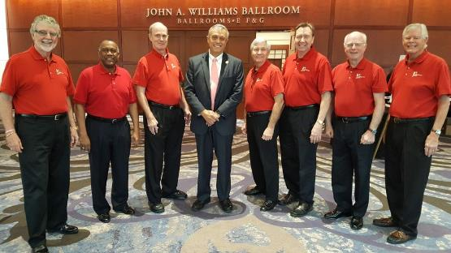
Opening music provided by Mt. Bethel Kingsmen. Many thanks for sharing your talents.

Slide 2
Annual Banquet
“We go overboard for Scouting”
February 2, 2024
Holy Family Catholic Church

Slide 3
Opening Flag Ceremony T2019(G)

Slide 4
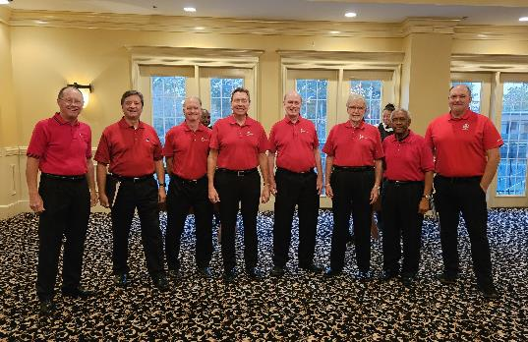
““We go overboard for Scouting”
A Scout is Reverent
Rev. Charlie Marus
Cobb Kingsmen

Slide 5
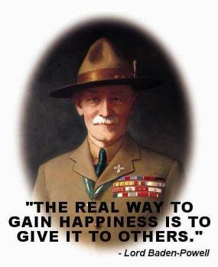
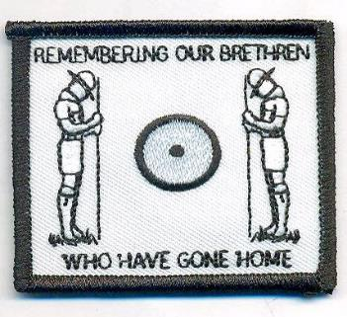
““We go overboard for Scouting”
A moment of silence to remember Foothills Scouters who have reached the end of the trail.

Slide 6
““We go overboard for Scouting”
Lee Miller
District Chair
Nathan Ray
District Executive
Julia Fedoryuk
District Executive
Tom Carden District Commissioner
Welcome from the Foothills District Key 3 (4)

Slide 7
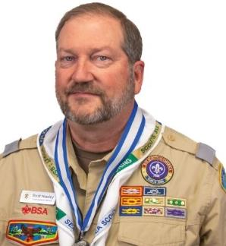
Banquet Honoree Scott Hawley
Overview and Summary
Married to Shelley with 4 children. 2 sons earned Eagle recognition. Foothills (Colossal Cobb) Eagle Scout class of 1974. Recently started Cub Pack 675 with Emma as a Tiger.
Roles - Current
Commissioner - Assistant Council Commissioner Service Area 4, Unit Commissioner – Silver Comet
COR – T675B, T675G, P675
Atlanta Area Council - Chancellor College of Commissioner Science 2024, University of Scouting Staff, Council Charter Partner Advisory Committee
Merit Badge Counselor
Roles - Past
252 (Pack. Troop, Crew) – Den Leader, Cubmaster, Committee Chair (Troop, Crew), COR
Commissioner – Unit Commissioner, Assistant District Commissioner, District Commissioner
District Committee - Member at Large serving in various roles.
Training and Honors
Wood Badge - Eagle – 92-71
District Award of Merit
Silver Beaver Award
Certified Angling Instructor (CAI)
Doctorate of Commissioner Science, Award of Excellence in Unit Service, Certificate of Commendation

Slide 8
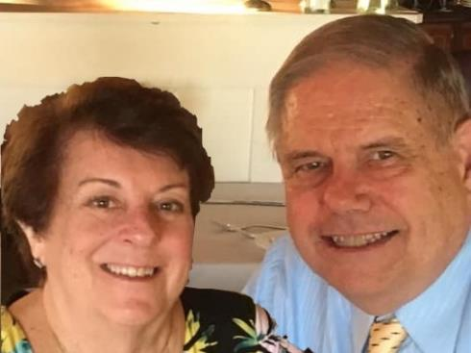
Jim Vaughn Lifetime Achievement Award
Ken was born in Roanoke, VA. Raised in Virginia, Ohio and North Carolina. Shirley was born and raised in Durham, NC.
Education:
Ken has BS in Aerospace Engineering from N. C. State University, MS in Mechanical Engineering from the University of Missouri, MS in Industrial Management from Georgia Tech, and post graduate certificates in aircraft design from the University of Kansas
Shirley attended Campbell College majoring in Accounting and Kennesaw State University in Music Education
Work:
After college Ken worked at McDonnell Douglas Aircraft in St. Louis for about five years primarily working on the F-4 and Harrier aircraft. He then moved to Marietta to work for Lockheed Martin Aeronautical Systems initially working on flight control systems on their aircraft. He transferred to work in simulation software design. After 40 years he retired as a department manager in the Simulation and Systems Integration Laboratories.
After college Shirley worked for Coca Cola Bottling Company first in Durham then in St. Louis in their accounting offices. She worked as an organist at various churches. She started her own business teaching piano and organ. She followed that working basically as a contractor doing accounting, especially payrolls, for various businesses.
Family:
Ken and Shirley have been married for 54 years living in St. Louis for five years before moving to Georgia in 1974. They have a son, Stuart, daughter-in-law, Jennifer, and three grandchildren, Bryce, McKenna and Addison. Stuart is Scout Executive for the Central North Carolina Council BSA. Jennifer is a kindergarten teacher. Bryce and McKenna are twins in their last semester of college. Addison has just graduated high school a semester early.
Ken and Shirley Williams
Instilling the values of the Scout Oath and Law into every Scout’s life.

Slide 9
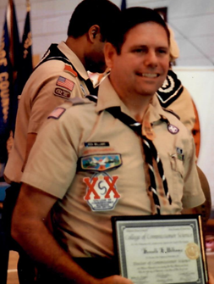
Jim Vaughn Lifetime Achievement Award
COUNCIL LEVEL - Atlanta Area Council
Scout Show Committee
Council Advancement Committee Member
CCS Faculty –
Instructor
Dean of Bachelor Program
Dean of Continuing Education Program
Dean of Masters Program
Assistant to Dean of the College
Assistant Dean of Doctorate Program
NATIONAL LEVEL -
National staff at the Scout Summitt Center for 2017 National Jamboree
Advancement Training at Philmont Training Center
HONORS and AWARDS:
Colossal Cobb District Banquet Honoree in 2000
God and Country
Cub Scout Leader Basic Training (October 15, 1983)
Scouter's Training Award (October 12, 1988)
Scouter's Key
Commissioner Fast Start Training (July 31, 1990)
District Award of Merit (May 15, 1993)
Commissioner Arrowhead (November 4, 1992)
Distinguished Commissioner as an ADC
Commissioner Key
Silver Beaver awarded Feb. 16, 1997
Bachelor of Commissioner Science in 1990
Master of Commissioner Science in 1991
Doctor of Commissioner Science in 1994
CURRENT POSITION(S) HELD:
District Commissioner Staff since 1987
Member at Large District Committee since 1986
HIGHEST RANK ACHIEVED AS A YOUTH: Life Scout
PRIOR POSITIONS HELD:
UNIT -
Cubmaster (Pack 751 - 1982 -1983).
ASM (Troop 75 1983 - 1986)
Scoutmaster (Troop 75 1986 - 1989)
Troop Committee Chairman (Troop 75 1989 - ?)
COR (Troop 75)
Troop Committee Member (Troop 75)
Explorer Post Assistant Advisor
Explorer Post Committee
DISTRICT - (Colossal Cobb and Foothills)
Commissioner Service
Unit Commissioner
Assistant District Commissioner
Roundtable Staff
Commissioner College Instructor/Staff
New Unit Commissioner (Yoda)
District Committee Member
Training, Advancement (Merit Badge Counselor Coordinator, Eagle Board of Review Coordinator), Health & Safety, Scout Expo, District Banquet, Membership, NOMCOM Chair 1997, Finance (FOS presenter). District Camporee Host Unit SM, Webelos Woods Coordinator
Ken and Shirley Williams
Instilling the values of the Scout Oath and Law into every Scout’s life.

Slide 10
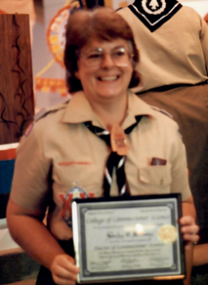
Jim Vaughn Lifetime Achievement Award
CURRENT POSITION(S) HELD:
Commissioner Staff since 1986
MAL District Committee since 1987
PRIOR POSITIONS HELD:
UNIT LEVEL –
Pack Committee Member (Pack 751 1981-1982)
Troop Committee Member (Troop 75 1983 - ?)
Explorer Post Assistant Advisor
Explorer Post Member of Committee
DISTRICT LEVEL - (Collossal Cobb and Foothills)
Commissioner Service -
Unit Commissioner
Assistant District Commissioner
Roundtable Staff
Annual Commissioner Conference Trainer
District Committee Member -
Vice Chairman of the District Committee
Training Committee
Advancement Committee
Health & Safety Committee
Scout Expo Committee
District Banquet Committee
Membership Committee
Merit Badge Counselor
COUNCIL LEVEL - (Atlanta Area Council)
Scout Show Committee
Commissioner College Faculty -
Instructor
Dean of Bachelor Program
Dean of Continuing Education Program
Dean of Masters Program
Assistant Dean of Doctorate Program
NATIONAL LEVEL –
Train the Trainer Course at Philmont Training Center
HONORS and AWARDS:
Commissioner Fast Start Training (July 31, 1990)
Scouter's Training Award (January 6, 1993)
Scouter's Key
District Award of Merit (May 13,1995)
Commissioner Arrowhead
Distinguished Commissioner as an Unit Commissioner
Commissioner Key
Bachelor of Commissioner Science in 1990
Master of Commissioner Science in 1991
Doctor of Commissioner Science in 1994
Colossal Cobb District Banquet Honoree in 1999
Foothills District Good Egg Award 2002
Ken and Shirley Williams
Instilling the values of the Scout Oath and Law into every Scout’s life.

Slide 11
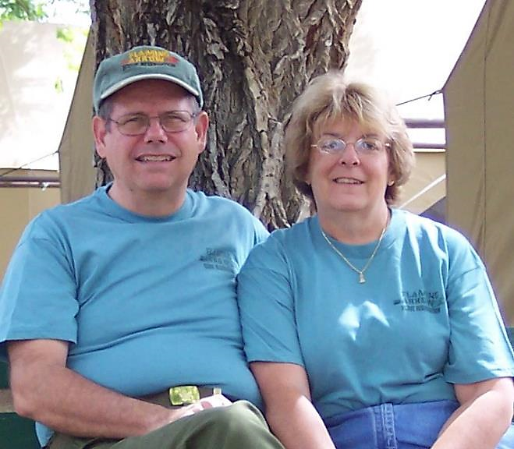
Jim Vaughn Lifetime Achievement Award
Ken
and
Shirley
Williams
Instilling the values of the Scout Oath and Law into every Scout’s life.

Slide 12
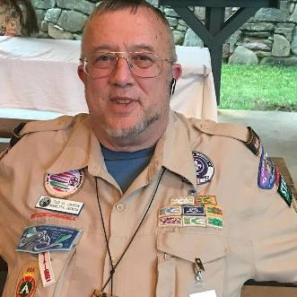
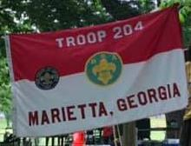
Congratulations
Troop 204
100th Eagle Scout
Presented by
Nathan Ray
District Executive

Slide 13
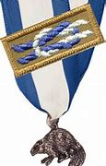
Silver Beaver
The Silver Beaver Award is the council-level distinguished service award of the Boy Scouts of America.
Upon nomination by their local Scout council and with the approval of the National Court of Honor, recipients of this award are registered adult leaders who have made an impact on the lives of youth through service given to the council.
The Silver Beaver is an award given to those who implement the Scouting program and perform community service through hard work, self-sacrifice, dedication, and many years of service.
It is given to those who do not seek it.

Slide 14
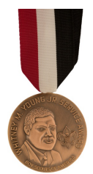
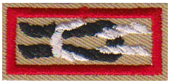
Whitney M. Young, Jr. Service Award – AAC 2023
The Whitney M. Young Jr. Service Award recognizes outstanding service by an adult or an organization for demonstrated involvement in the development and implementation of Scouting opportunities for youth from rural or low-income urban backgrounds.
The nominee has made a significant contribution while acting as an advocate for rural or low-income urban youth, encouraging outreach to improve their conditions, and sensitizing Scouting’s and America’s leadership to these conditions, or other administrative support necessary to make Scouting effective in rural or low-income urban communities.
The Whitney M. Young Jr. Service Award is presented to people at all levels of the organization (executive board, district Scouters, unit personnel) and to people of all races and income levels.
Dale Hajost

Slide 15
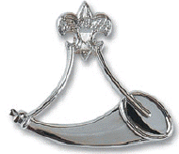
Advanced Training Overview Every Scout deserves a Trained Leader
Wood Badge
National Youth Leadership Training
Powder Horn
Position Specific
Other?

Slide 16
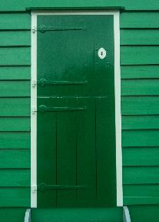
““We go overboard for Scouting”
Mike Lotz

Slide 17
“We go overboard for Scouting”
Recognition of Professionals and Special Guests
Larry Labbe

Slide 18
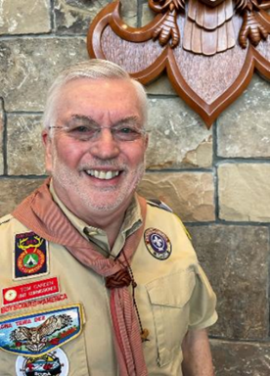
“We go overboard for Scouting”
Commissioner Recognition
Tom Carden
District Commissioner

Slide 19
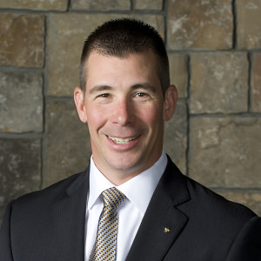
“We go overboard for Scouting”
State of the Council
Jason Volz
Atlanta Area Council
Chief Operating Officer

Slide 20
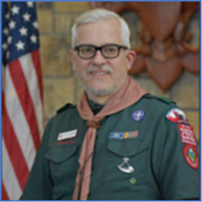
“We go overboard for Scouting”
State of the District
Lee Miller
Foothills District Chair

Slide 21
2023 Recipients
Name | Type | Unit | Name | Type | Unit
Lewis Hays | District |  | Mark Roberts | Pack | 744
Tami Crutchfield | Pack | 75 | Tyler Misel | Pack | 797
Stephanie Daigle | Pack | 277 | Jenna Knight | Pack | 797
Victoria Freeman | Pack | 277 | Katie Lejman | Pack | 797
Shaniah Alishio | Pack | 277 | Matt Glazebrook | Pack | 815
Cassandra Price | Pack | 277 | Jonathan Jeffries | Pack | 815
Chaka Wilson | Pack | 312 | Rosie Jeffries | Pack | 815
Kimberly Steegman | Pack | 700 | Chris Powers | Pack | 815
Phillip Korn | Pack | 744 | Peter Hicks | Pack | 1217
James Stovall | Pack | 744

Slide 22
2023 Recipients
Name | Type | Unit | Name | Type | Unit
Thomas McGill | Troop | 144 | Cynthia Roberts | Troop | 444 (G)
Gil Warren | Troop | 144 | Murugesan Parthasarathi | Troop | 772
(George) Stephen Crissey | Troop | 204 | David Clary | Troop | 955
Dale Byrd | Troop | 312 | Ian Watts | Troop | 955
Laura Mills | Troop | 433 | Richard Daniels | Troop | 2019
David Linsey | Troop | 433 | Heather Glazebrook | Troop | 2019
Beth O'Neal | Troop | 433 | Steve Carlin | Troop | 2319
Rebecca Alexander | Troop | 444 | Andy Duke | Troop | 2319
Mary Chappell | Troop | 444 | Scott Kerns | Troop | 2319
 |  |  | Jason Arnold | Troop | 2319(G)

Slide 23
“We go overboard for Scouting”
Mike Lotz

Slide 24
Scouting's Journey to Excellence
Unit | JTE Level | Unit | JTE Level | Unit | JTE Level
Pack 57 | Gold | Troop 75 | Gold | Troop 444(B) | Gold
Pack 75 | Gold | Troop 144 | Gold | Troop 479 | Gold
Pack 121 | Gold | Troop 204 | Gold | Troop 714 | Gold
Pack 252 | Gold | Troop 252 | Silver | Troop 772 | Gold
Pack 571 | Gold | Troop 277 | Gold | Troop 795 | Gold
Pack 700 | Gold | Troop 287 | Gold | Troop 955 | Gold
Pack 797 | Gold | Troop 312 | Gold | Troop 2019 | Silver
Pack 815 | Gold | Troop 433 | Gold | Troop 2319(B) | Gold

Slide 25
District Honor Roll a.k.a. The Chicken Pin
2023 Units earning the coveted Foothills District Chicken Pin
PACK 57 | TROOP 75 | TROOP 444 (B)
PACK 75 | TROOP 144 | TROOP 714
PACK 121 | TROOP 204 | TROOP 772
PACK 571 | TROOP 277 | TROOP 795
PACK 797 | TROOP 287 | TROOP 955
PACK 815 | TROOP 312 | TROOP 2019 (G)
 | TROOP 433 | TROOP 2319 (B)

Slide 26
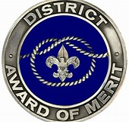
District Award of Merit Presented by Hilary Thornton
GENERAL INFORMATION
The District Award of Merit is a council award presented by districts in the same manner that the Silver Beaver is a national award presented by councils. The award is available to Scouters who render service of an outstanding nature at the district level. The award is made available annually on the basis of 1 for each 25 traditional units or fraction thereof.
REQUIREMENTS
1. A nominee must be a registered Scouter.
2. A nominee must have rendered noteworthy service to youth in Scouting, outside Scouting, or both.
3. Consideration must be given to the nominee’s Scouting position and the corresponding opportunity to render outstanding service beyond the expectations of that Scouting position.
4. The nominee’s attitude toward and cooperation with the district and/or council is to be taken into consideration.
5. Nominations cannot be considered for posthumous awards.

Slide 27
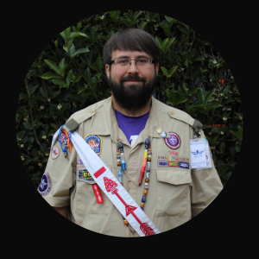
Council/Lodge Level:
Lodge Media & Publications Adviser 2020-2022
Lodge Assistant Webmaster 2019-Present
Lodge Master Adviser 2024-Present
Venturing Officers Association Advisor 2024-Present
District/Chapter Level:
Kennesaw Chapter Adviser 2016-Present • Kennesaw Chapter Webmaster 2016-Present • Foothills District Webmaster 2017-2022 and Communications Chair 2017-2022
Unit Level:
Troop 75 Assistant Scoutmaster, Equipment Coordinator 2012-2018
Troop 2319-B Assistant Scoutmaster 2018-2021, Equipment Coordinator 2018-2023, Webmaster
Troop 2319-G Assistant Scoutmaster, Equipment Coordinator, Webmaster 2022- Present
Crew 2319 Adviser, Webmaster 2020-Present
Training:
IOLS • NYLT • Short Term Camp Admin • Catholic Religious Emblem Counselor • Merit Badge Counselor • Assistant Scoutmaster Position Specific • Committee Member • YPT
Other:
OA Vigil Honor Recipient 2021
Eagle Scout 2012
Bronze Pelican Recipient 2016
Foothills District Good Egg Recipient 2019
Troop 2319-B Good Egg 2020, Troop 2319-G Good Egg Recipient 2022
Lead Troop 2319-B to achieving OA Unit of Excellence 2019-2022
Lead Crew 2319 to achieving OA Unit of Excellence 2020-2022
Catholic Religious Emblem Counselor 2013-2019
Trailblazer Adventure Camp Commissioner 2017-2022
Very instrumental in growing and strengthening Kennesaw Chapter
Andrew Budzinski
District Award of Merit

Slide 28
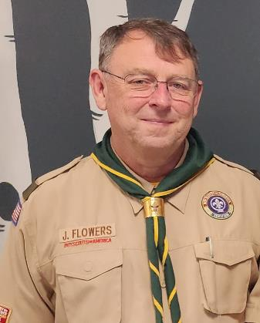
Scouting Roles
Current
Unit
Assistant Scoutmaster – Troop 1011
Foothills District Committee
Eagle Advancement Chair
Member at Large
Merit Badge Counselor
Past
Scoutmaster – Troop 1011
December 2016 – September 2023
Jim Flowers
District Award of Merit

Slide 29
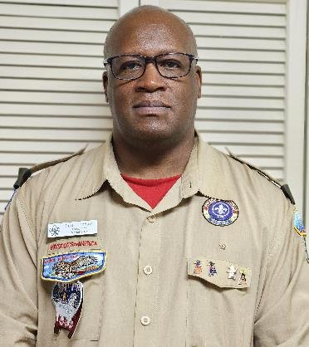
Current Scouting Roles
Foothills Assistant Roundtable Commissioner – District Webmaster
Troop 277 – Committee Chair
Past Scouting Role
District Member-at-Large – Camp Card Chair 2X
Troop 277 – ASM, Committee Member
Pack 277 – Committee Chair
Training, Awards, and Honors
Good Egg recipient First recipient of the Fun Key Chicken award
First Aid/CPR/AED Trained
OA Member
Personal
Active member of the Factory Church, Woodstock, GA
Serve the community by serving food to the homeless in Atlanta
Volunteer Truck driver for Food Pantry – Forever Fed Husband for 27 years to wife Vilma (Girl Scouts)
Dad to college bound daughter Olivia
Dad to son Joseph (Joey) - Life Troop 277
26 years System Engineer at Warner Brothers Discovery (Turner Broadcasting)
Enjoys spending free time watching football and basketball.
Paul Thomas
District Award of Merit

Slide 30
Britta’s
Bon Voyage!

Slide 31
“We go overboard for Scouting”
2023 Banquet Committee
Wayne Marcinko - Chair | Becky Borders | Darden Borders | Tom Carden
Fred Feltmann | Scott Hawley | David Jaracz | Larry Labbe
Mike Lotz | Lee Miller | Laura Mills | Wade Patrick
Britta Smith | Martin Smith | Kes Stadler | Hilary Thornton

Slide 32
“We go overboard for Scouting”
Thank you for being a part of Foothills District’s celebration of our awesome Volunteers!

