Slide 1
BSA Annual Membership and Unit Renewal Work Shop
November 6, 2024
7:00PM -8:00PM

Slide 2
Welcome and Introductions
Objective Today
Help Units with Membership Renewal
Presenters
Louis Todd, Council Commissioner
Ben Buckelew, Director of Field Service
Donna Carr, Atlanta Area Council Registrar
A Few Reminders…
FAQ’s update
Submit questions in Q&A
Is this recorded? Yes.

Slide 3
Safety Moment
Notes:
Remind leaders that all adults going on overnight trips/campouts must be registered in any position within the unit, district or council other than Merit Badge Counselor.

Slide 4
Membership & Unit Renewal Process
https://www.scouting.org/resources/unit-and-membership-renewal/
Notes:
Slide one
As a reminder there are job aids and details on both the unit renewal and member renewal found at www.scouting.org\resources\unit-and-membership-renewal/ to answer additional resources are created they will be added to this website.

Slide 5
IS YOUR UNIT READY FOR
MEMBER & UNIT RENEWALS?
Member Renewal and Unit Renewal are now separate processes. They are more straightforward, but units must make some decisions.
Is your unit ready?
Your Commissioners and Council are here to assist you!
For more details, visit the Unit and Membership Renewal web page.
Notes:
Separate Processes
Member Renewal and Unit Renewal are now separate processes.
Members now renew annually based on when they join.
Key Decisions and Actions to Make Early
Verify correct emails for all members.
Ensure every Scout under 18 has an associated parent’s/guardian’s email.
Decide payment method:
Unit Pay: The unit pays for members’ registrations in the month due
Self Pay or Family Pay: Let members/parents manage renewals.
Choose auto-renewal or manual approval.
Communication – early and as often as necessary
Inform parents/members of decisions.
Clarify steps for renewal.
Be prepared for:
3% credit/debit card fee.
Adult registrations may be delayed for background checks.

Slide 6
Unit Renewal Process
Changes made in the spring of 2024

Slide 7
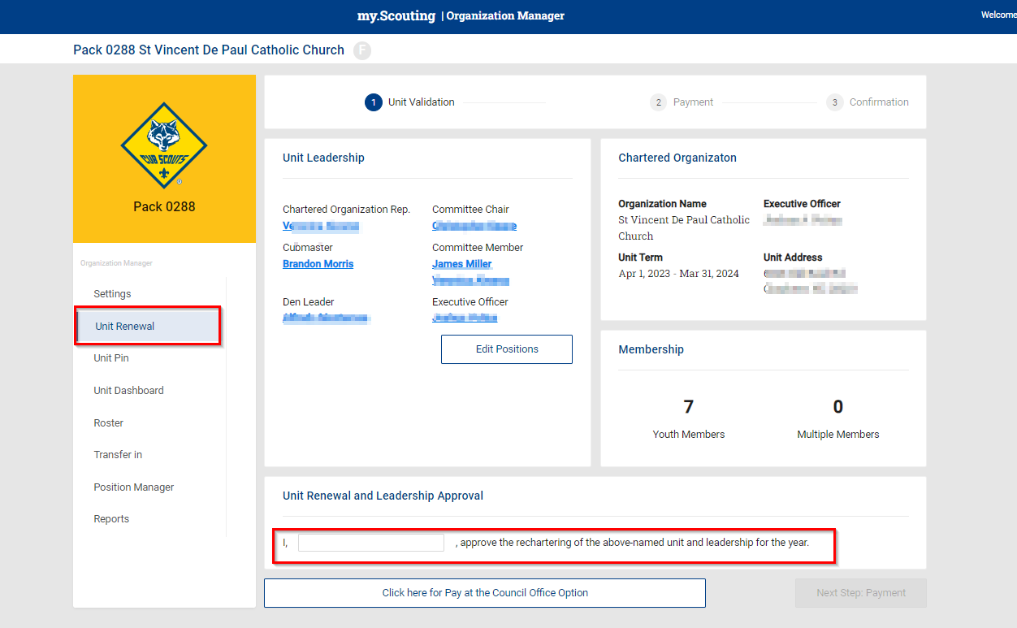
Notes:
This can be accessed via your My.Scouting account. Simply log in to my.scouting. Go to the menu in the upper left hand corner (instructions sheets for this will be on our webpage soon) using the dropdown menu, scroll to Organization and click on the unit you are working with. You will find this screen by clicking on Organization Manager, Unit Renewal. If you need to change any of the volunteer positions, it is highly recommended that be done in the Position Manager before you start the process and not during this review.

Slide 8
Notes:
After the Unit Renewal is reviewed and good to go, use the electronic signature for approval. You can opt to use the Pay at the Council Option. This is a must use if you have Scouts that need financial assistance from the council to renew. (Be sure and get with your District Professional to work that part out.) If you choose to use the pay online option, use Next Step Payment – it is recommended that you do this. To the best of our knowledge, you will be able to use either a credit card (3% upcharge or an echeck $1 processing fee.

Slide 9
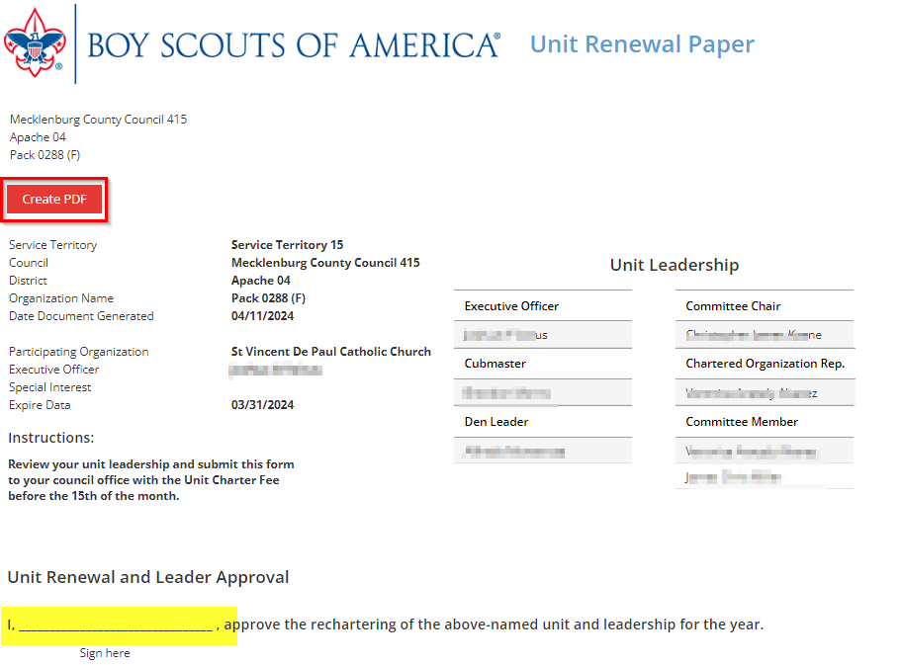
Notes:
Your Charter Org Rep will need to sign on this form. You will want to print this out for your records or create a PDF and file in the unit history.

Slide 10
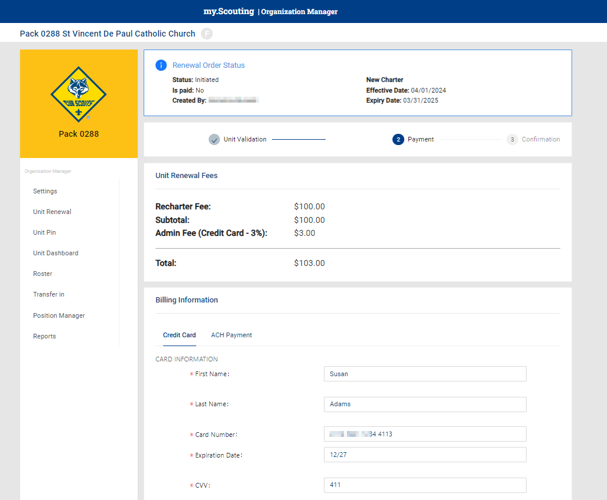
Notes:
You will get this page to finish the payment process and you will need to complete all the information for a smoother process.

Slide 11
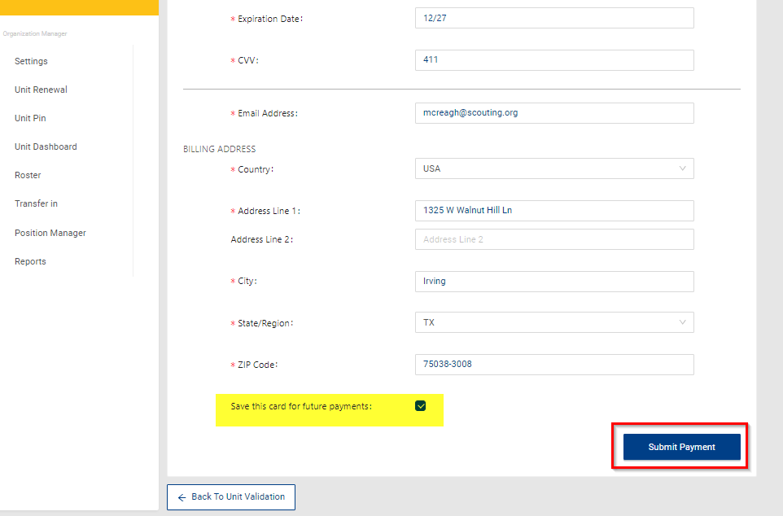
Notes:
You will have the option to save the unit’s credit card info for future payments. Click on the Submit Payment.

Slide 12
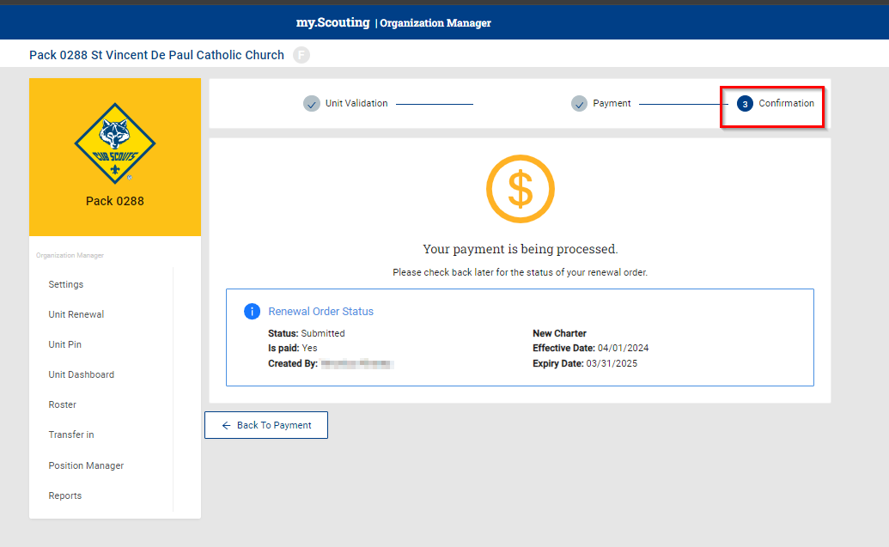
Notes:
While the payment is being processed, you will see this screen.

Slide 13
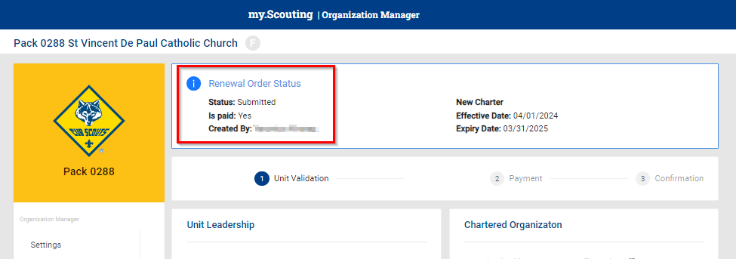
Notes:
And the final step for the Unit Renewal.

Slide 14
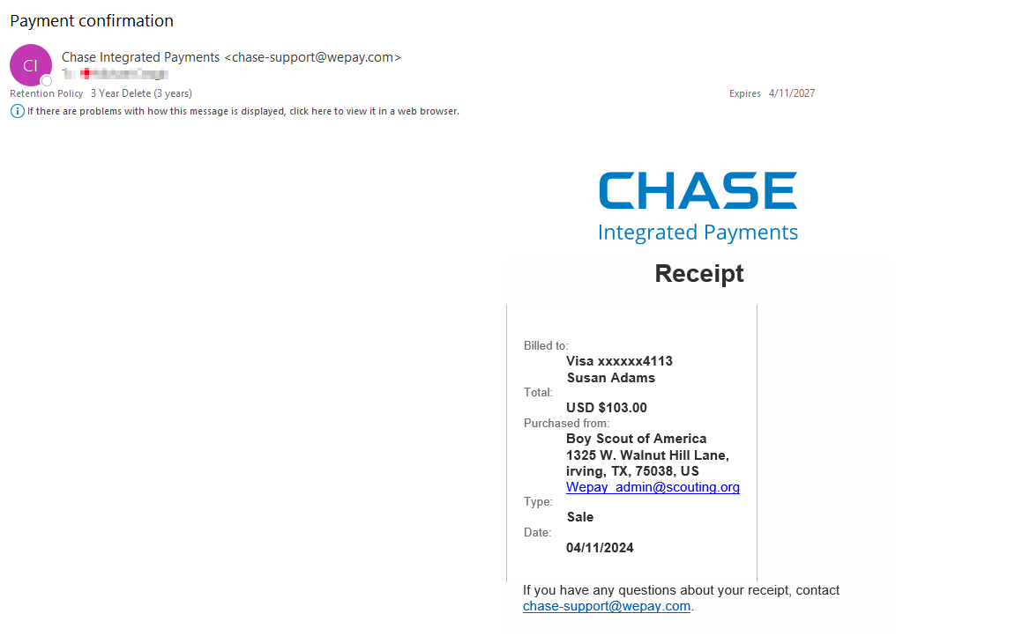
Notes:
You will also receive a receipt to share with your unit treasurer.

Slide 15
Member Renewal Process
Personal Renewal

Slide 16
Membership Renewal
For all youth and adult members of the BSA
Note: All registrations are for 12 months. For example, if your current registration expires on 12/31/2023, your renewed membership will start on 1/1/2024 and run through the entire calendar year until 12/31/2024. Membership renewal can be completed by either the individual, the family or the unit.
Membership Renewal Family/Self Pay/Auto-Renewal
Membership Renewal Unit Pay
An email notification and a renewal link will be sent 60 days before membership expires.
The link provided in the email will direct individuals to a renewal form on My.Scouting.
If registered in multiple positions, select the primary position. Renewing the primary position will automatically renew multiple positions.
The individual pays with a credit card and submits the renewal.
In Organization Manager, the unit selects the Unit Pay option.
Unit Key 3s are notified twice a month about which members are due to renew that month.
Using the Roster tab, the unit selects which members they are renewing.
The unit can choose not to renew a member (opt-out). The unit can also change the Scout’s Life subscription settings for each person.
The unit pays with a credit card or establishes a securely stored electronic fund transfer payment (ACH) and submits the renewal.
Notes:
There are three different ways that members can renew today, first of all the unit has the ability to process registration for all youth and adults, also the family or the member has the ability to do registration online and the third process is that either method whether it's the unit organizing or the individual organizing can turn their renewal into the council office.

Slide 17
Auto-Renewal Membership
For all youth and adult members of the BSA
Note: All registrations are for 12 months. For example, if your current registration expires on 12/31/2024, your renewed membership will start on 1/1/2025 and run through the entire calendar year until 12/31/2025. Membership renewal can be completed by either the individual, the family or the unit.
Notes:
Family/Self Pay
An email notification and a renewal link will be sent 60 days before membership expires.
The link provided in the email will direct individuals to a renewal form on My.Scouting
If registered in multiple positions, select the primary position. Renewing the primary position will automatically renew multiple positions.
The individual pays with a credit card and submits the renewal.
The unit will approve the membership renewal.
In Organization Manager, the unit selects the Unit Pay option.
Unit Key 3s are notified each month about which members are due to renew that month.
Using the Roster tab, the unit selects which members they are renewing.
The unit can choose not to renew a member (opt-out). The unit can also change the Scout’s Life subscription settings for each person.
The unit pays with a credit card or establishes a securely stored electronic fund transfer payment (ACH) and submits the renewal.

Slide 18
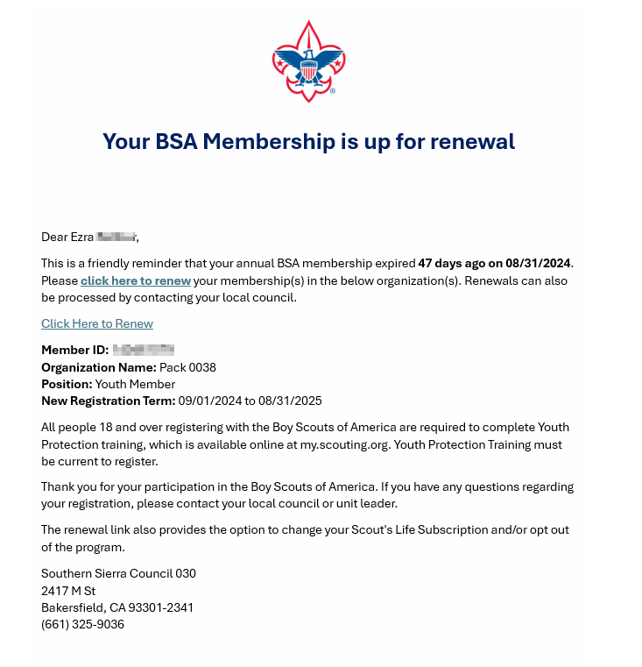
Renewal E-Mail

Slide 19
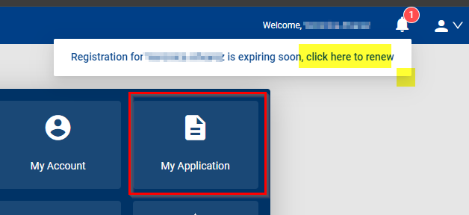
Notes:
The Family or individual will log into their my.scouting account. On the landing page, they will click on My Application. For those of you who are trying it now, you can look but you can’t go ahead and renew now. You will have to wait until October.

Slide 20
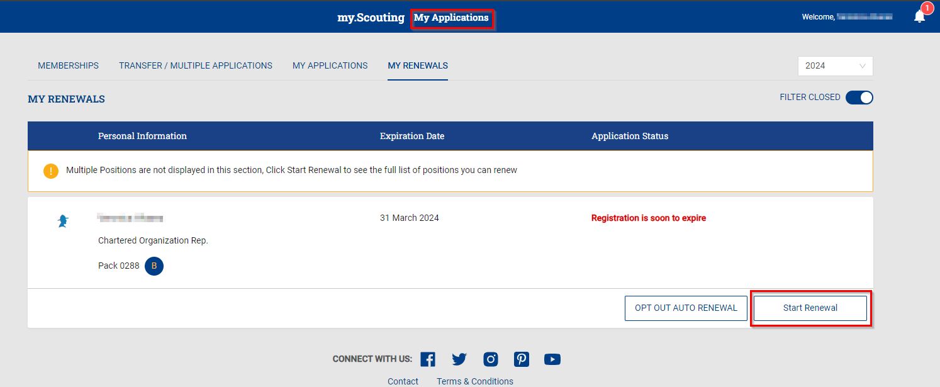
Notes:
After you have accessed your My Applications, click on My Renewals. If you see that everything is good and this is your ‘Primary or Paid’ registration, click on Start Renewal or if you don’t want to continue, click on the Opt Out Auto Renewal button.

Slide 21
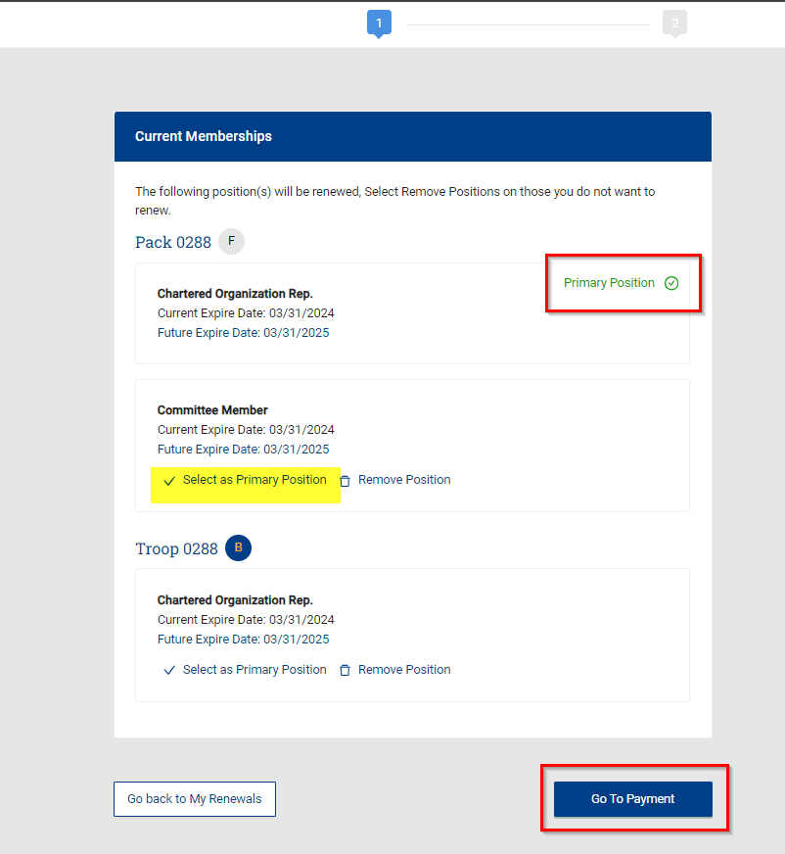
Notes:
After you have started the renewal process, you can change which one is to be your Primary/Paid position or you can actually remove any other positions you may be holding such as Merit Badge Counselor or other by clicking on the Remove Position button. If you are happy with your renewal, click on Go To Payment.

Slide 22
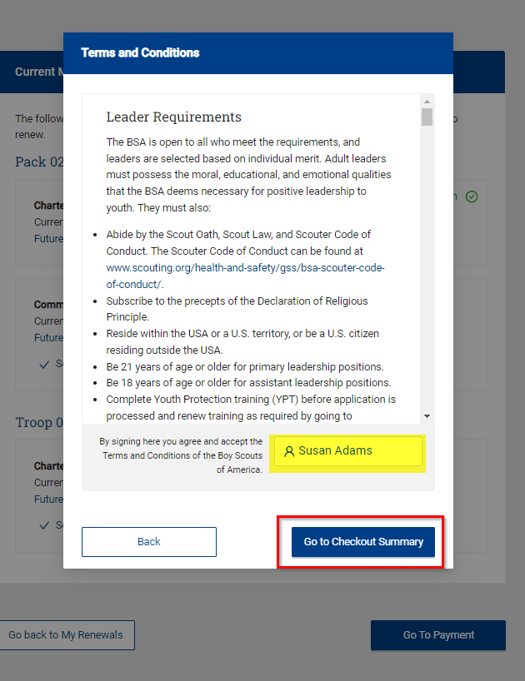
Notes:
You will be asked to sign the Leader Requirements which include abiding byt the Oath, Law and Code of Conduct, adhere to the precepts of the Declaration of Religious Principle, Reside in the USA, among other topics. Once you have read it and agree, you should click on Go To Checkout Summary.

Slide 23
Notes:
You will see a page that looks like this. Please review carefully. Also, this particular test registration shows a Council Fee. The Atlanta area council does not currently require you to pay more to Scout.

Slide 24
Notes:
Once you are done with your review of the fees, scroll down the page and enter your billing info and Place Order.

Slide 25
Unit Paid Member Renewal
When the Unit Chooses to Renew their Members

Slide 26
Notes:
You will log into your unit via my.scouting and your unit. In Organization Manager, you will see the options to either Auto Approve Renewals or Renewal Payment which means the unit will work with their membership to collect the fees. Please choose one. And click save.

Slide 27
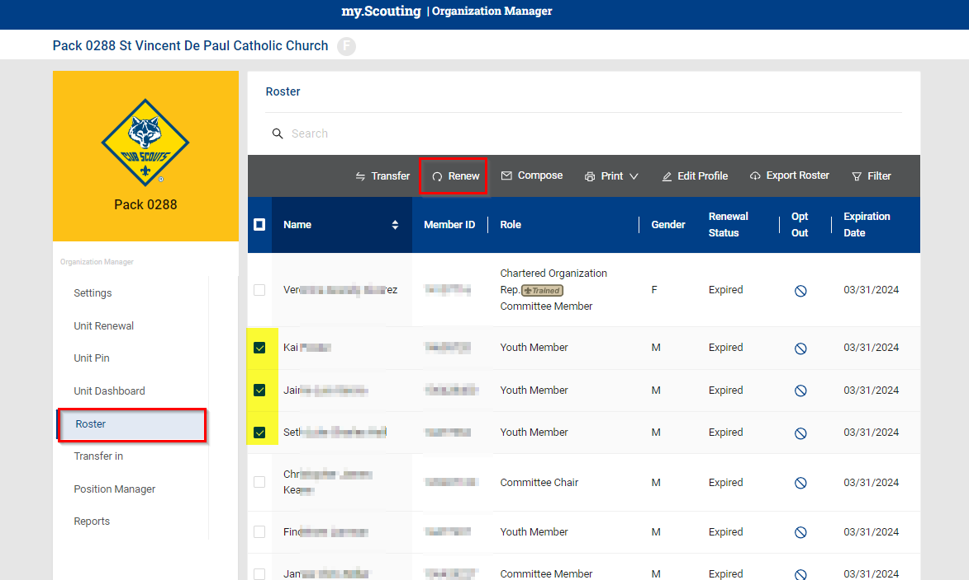
Notes:
From the Organization Manager, you can access your roster 24/7. The roster gives you the expiration dates on every member and if you have chosen the Unit Pay option will require someone to monitor so no one that wants to continue expires. But if they do, it is not a crisis, we can get them back in the system. You will simply select the ones you want to renew, check the box to the left of the name and then click Renew in the blue ribbon at the top part of the Roster Screen.

Slide 28
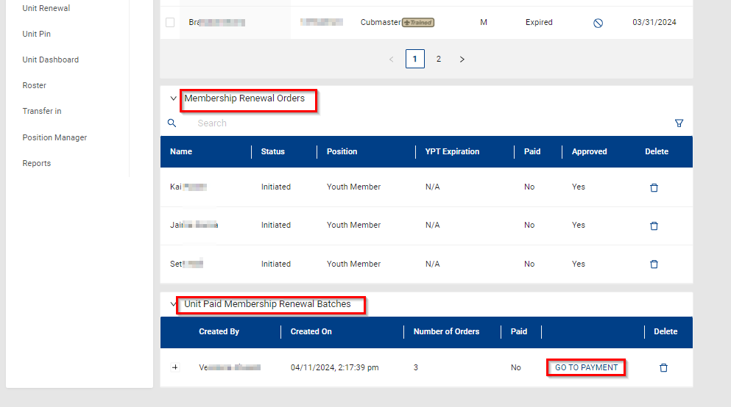
Notes:
After you have selected your batch to renew, you get another chance to review it and of course Go To Payment to complete the order.

Slide 29
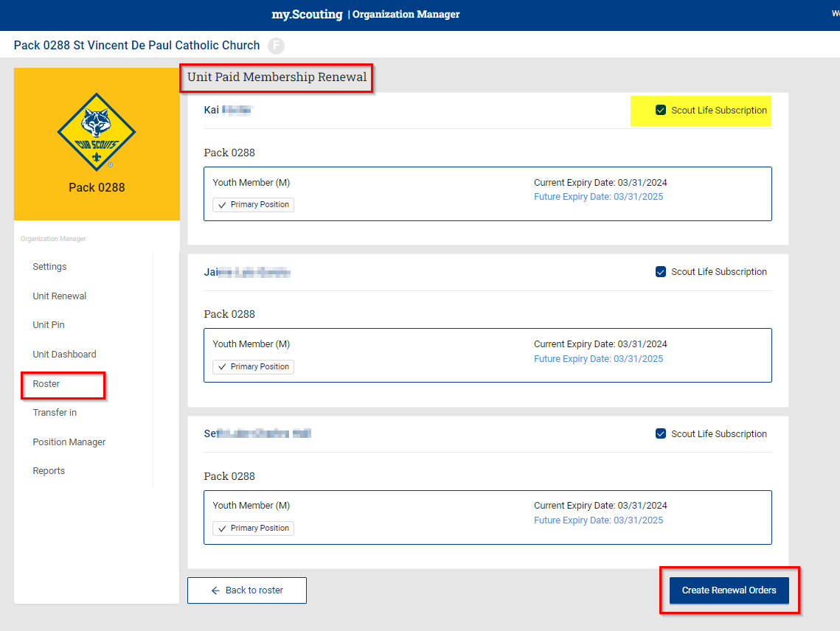
Notes:
Review the order and if they do not want Scout Life Magazine, this screen is your opportunity to remove it. Once you are done, click on Create Renewal Orders.

Slide 30
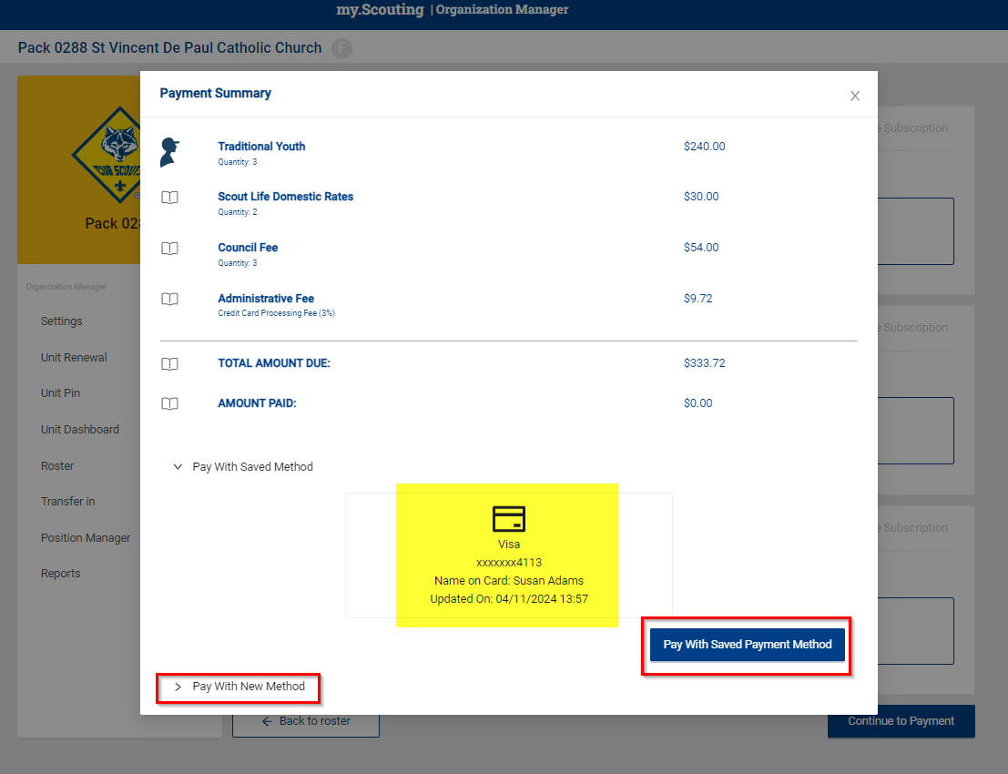
Notes:
And now for the final step! Click on Pay with Saved Payment Method. Ta Da!

Slide 31
Reporting
Found in Organization Manager

Slide 32
Notes:
You have access to all of these reports and more, they are all located in the Organization Manager. Simply click on the Reports tab and try them all out!

Slide 36
Unit Leader Renewal E-Mail
Twice a month
Includes:
Renewals
Opted – Out
Drops

Slide 37
Membership & Unit Renewal Process
https://www.scouting.org/resources/unit-and-membership-renewal/
Notes:
Slide one
As a reminder there are job aids and details on both the unit renewal and member renewal found at www.scouting.org\resources\unit-and-membership-renewal/ to answer additional resources are created they will be added to this website.

